Slide 1
Project Presentation(Group 5)
Sriram Rajiv Karri (11170417)
Vijay Sai Chigullapally (11810022)
Ruthvik Bairaboina (11819162)
Fahmida Yasmin Rifat (11812777)
Muhammad Zubair Hasan (11812741), Team Leader

Slide 2
Finbot: Personal Finance Management with Chatbot

Slide 3
Product Vision
FOR people facing challenges in managing their finances WHO wants to track their personal daily transactional activities and categorize the amount they spend and get some insights on their purchases THE FinBot: AI-Driven Personal Finance Manager is a mobile application THAT tracks daily transactions, financial goals and categorizes spending based on receipt images using AI UNLIKE other apps like wallet, mint and ynab etc. which only handles daily finances in manual manner. OUR PRODUCT provides AI-assistance with which users can generate customized financial reports and get answers regarding financial history questions through a chatbot.

Slide 4
Features
Customized Reports
Personalized AI Chatbot
Goals and Notifications
Daily Tracking of Transactions
Categorizing Expenses from Receipt Images

Slide 5
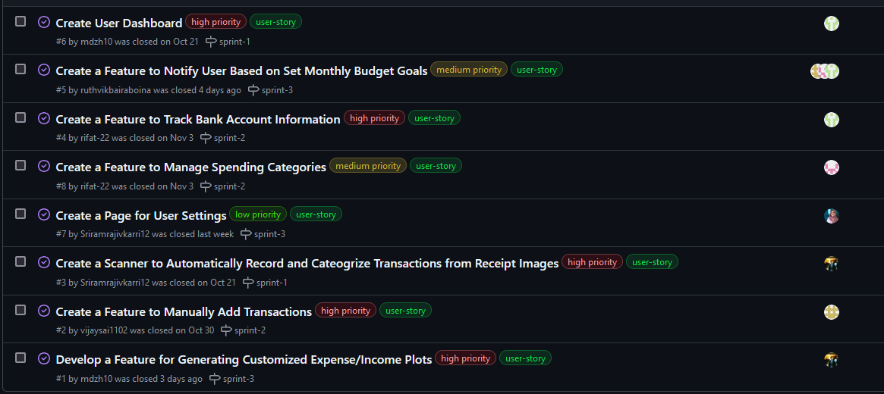
User Stories Sorted

Slide 6
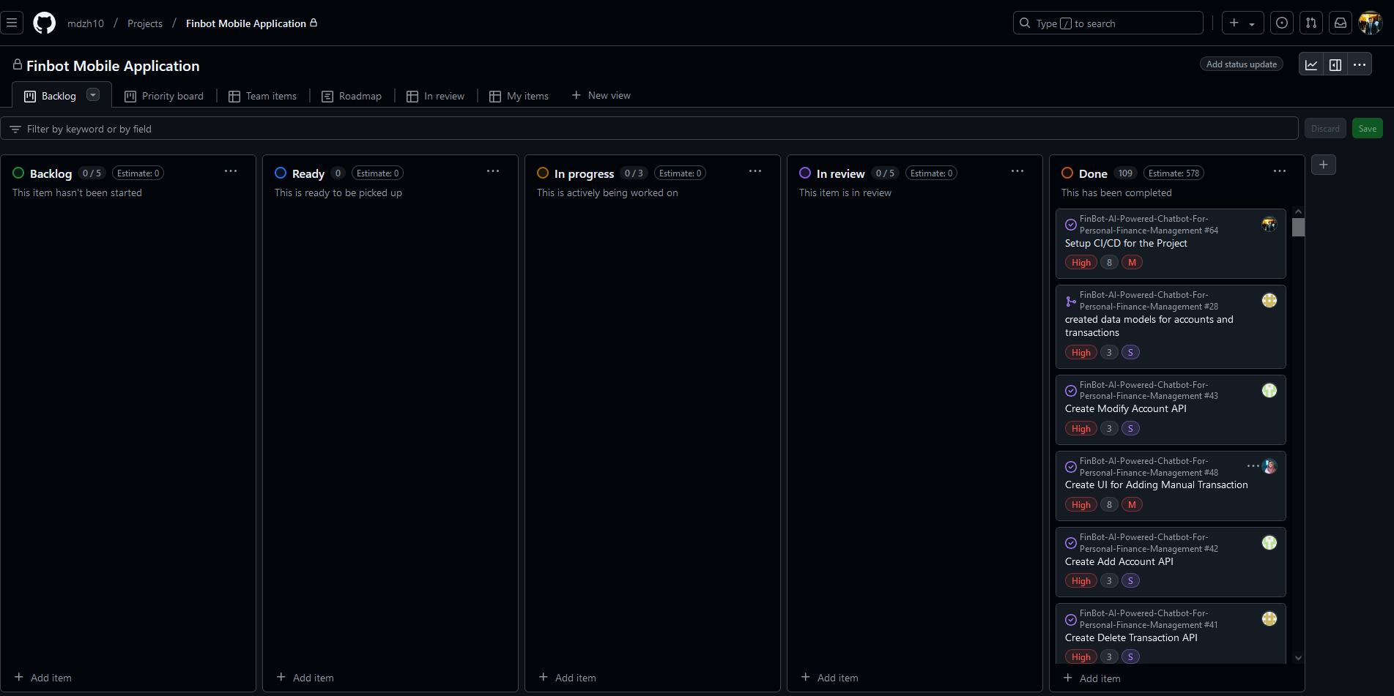
Project Kanban Board

Slide 7

Technical Stack Overview
Development Platforms: Ubuntu/Windows, Ram: 8GB, Intel Core i7 CPU, Android Studio
Frontend: Flutter
Language: Dart, Python
Database: PostgresSQL
Version Control & Issue Tracker: GitHub
Prototype tool: Figma, Visily
Deployment: CI/CD
Backend: FastAPI, ChatGPT

Slide 8
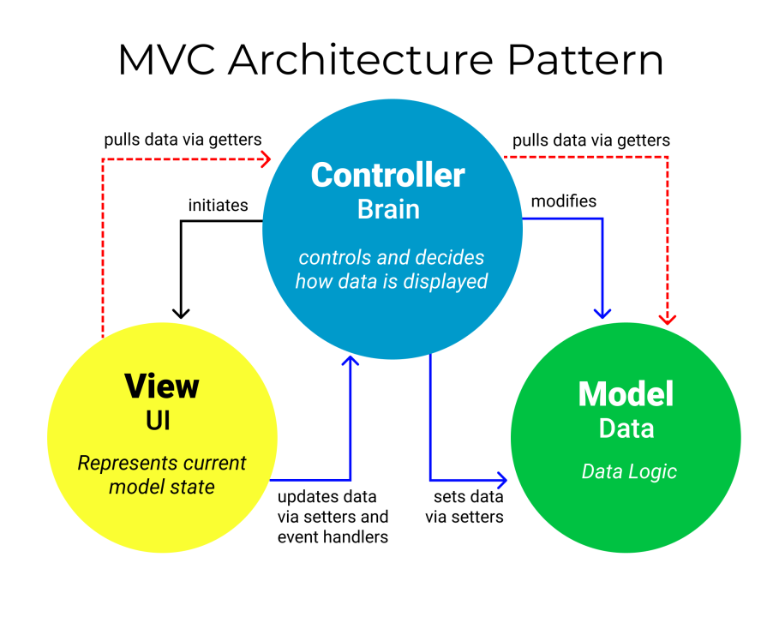
Software Architecture

Slide 9
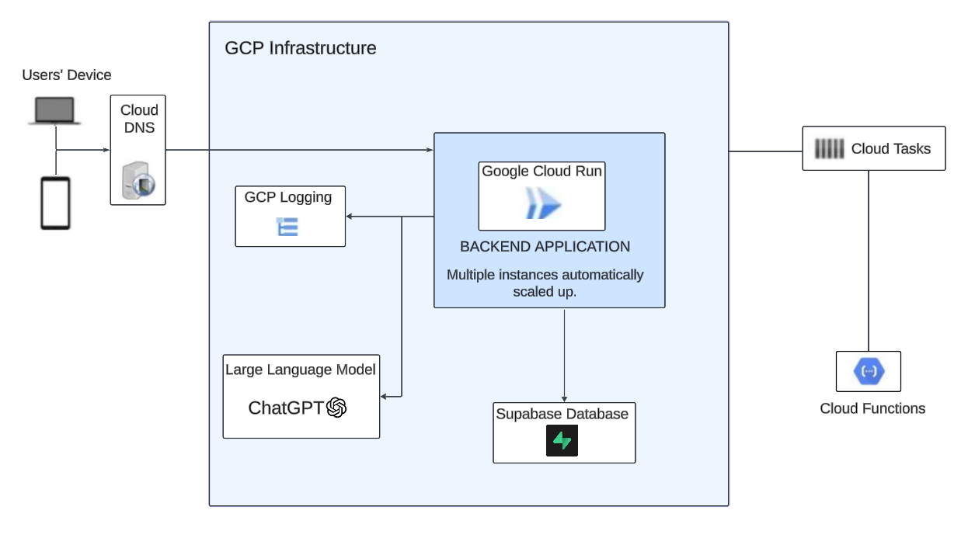
Cloud Infrastructure(GCP)

Slide 10
Enabled APIs for GCP
Artifact Registry API
Cloud Run Admin API
Secret Manager API
Service Usage API
Cloud Build API

Slide 11
GitHub - Overview of the Sprints
Git Repository
Completed User Stories
Sprint Overview
Successfully fixed bugs and improved logics every week and new knowledge gained every week by team members. Delivered cleaner code and presented this during sprint review meetings. Gradually made improvements on frontend and backend integration.
CI/CD Pipeline Setup
Application Dockerization
Deployed the Application

Slide 12
DevOps Metrics (Since Sprint 3)
Process Measurement Metrics
Deployment frequency
Failed
Deployments (%)
Mean Time to Recovery (MTTR):
Week 1: 1 MR deployed
Week 2: 11 MRs
Week 3: 25 MRs
Week 1: 0%
Week 2: 27.27%
Week 3: 12% (Improved stability).
Lead Time
Change Volume
Week 2: 1.1 hours
Week 3: 1.2 hours (CI/CD implemented).
Week 1: 18 minutes
Week 2: 15 minutes (improved).
Week 3: 25 minutes (needs attention).
Week 1: 25 commits
Week 2: 7 commits
Week 3: 23 commits.

Slide 13
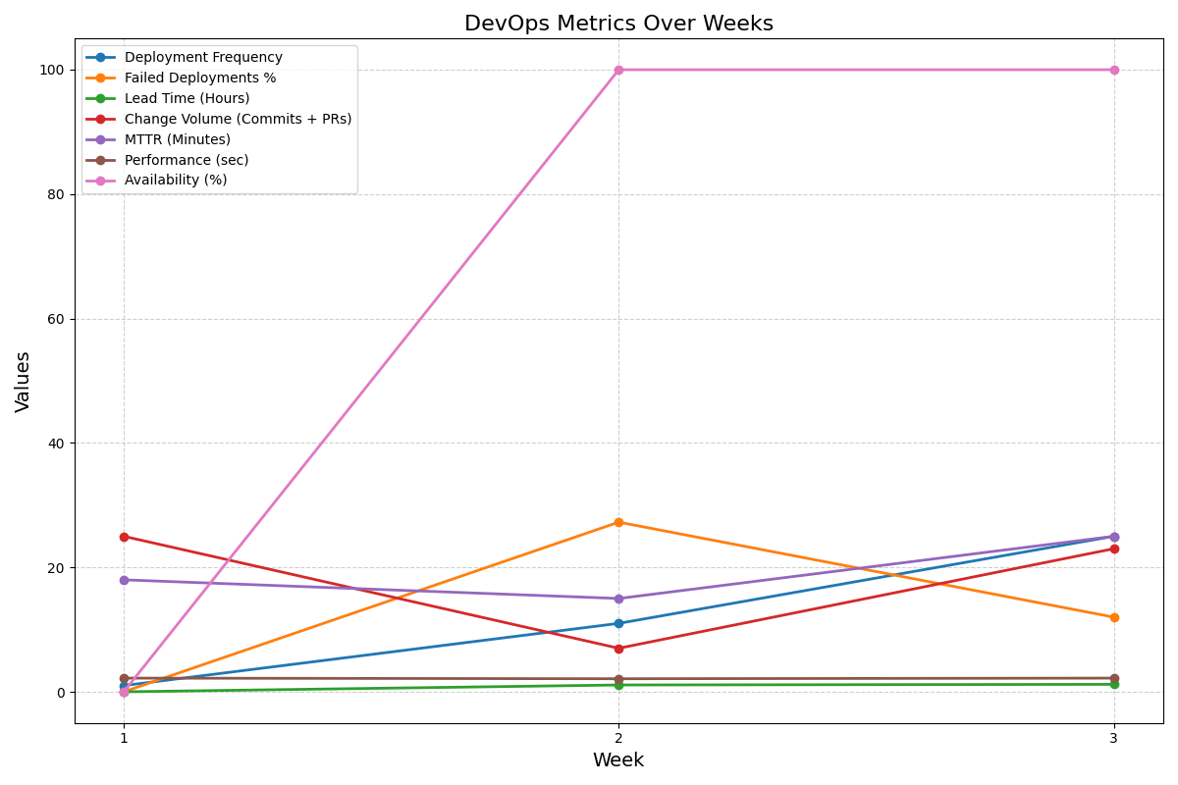
DevOps Metrics (Since Sprint 3)

Slide 14
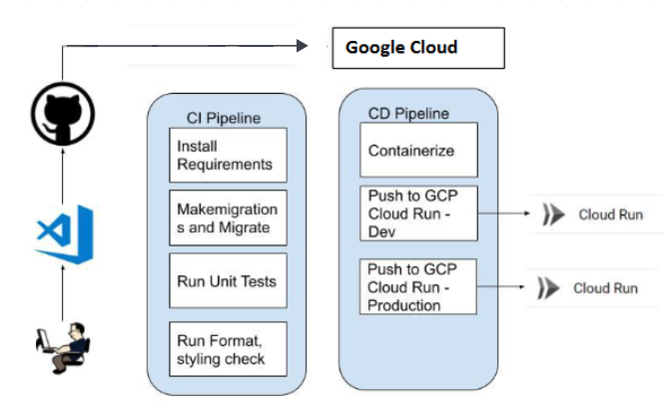
CI/CD Pipeline

Slide 15
Demo
Appilication Flow in UI: https://docs.google.com/document/d/1B9SjdE6f__XLyl0aZCDK7u7WGmj21tHTyaASubKV0rE/edit?usp=sharing
Video: https://www.youtube.com/watch?v=t-F69v4N-T4

Slide 16
Thank You

